Slide 1


Department of ECE
COURSE:
Processors and Controllers
COURSE CODE:23EC2106R
Topic:
CO1-8086

Slide 2


Computer System and Languages

Slide 3
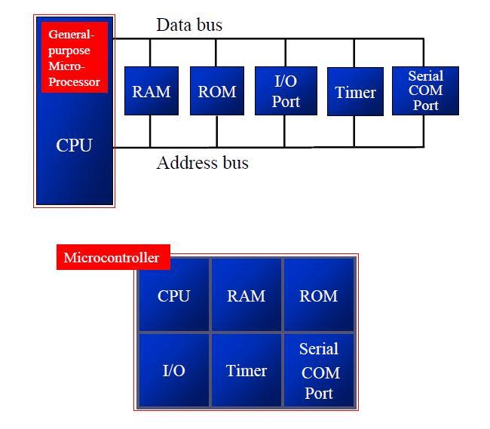
To start your Learn in embedded domain, you need to have the following skills.
Embedded Systems are the electronic systems that contain a microprocessor or a microcontroller.
2. Working on Assembly language Programs for Target devices like 8086 and 8051.

Slide 4
Features of 8086
The 8086 is a 16-bit processor. It means ALU, its internal registers & most of its instructions are designed to work with 16-bit data.
The 8086 has a 16-bit data bus.
The 8086 has a 20-bit address bus so it can have a maximum of 1MB of memory. It has 16-bit I/O address so it can access up to 64K I/O ports.
The data bus and 16-bit lower order address bus is multiplexed.
The 8086 has Fourteen 16-bit registers.
The 8086 requires a clock with 33% duty cycle for its internal timing. Its clock speed is 5MHz, 8MHz or 10MHz.
The 8086 has a powerful instruction set with a range of addressing modes. It can perform bit , byte , word & block operations.
The 8086 has two mode of operations Minimum & Maximum. In minimum mode it works as a single microprocessor. Where as in maximum mode it work in Multiprocessor configuration.

Slide 5
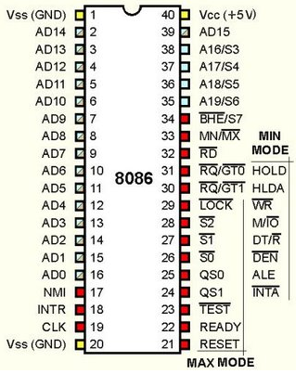
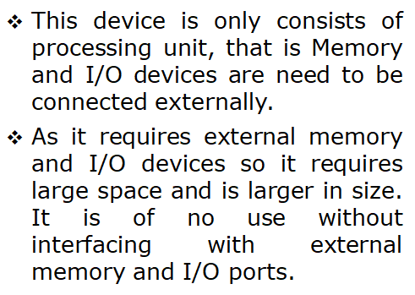
8086 Microprocessor

Slide 6
Pins and signals

Slide 7
Pins and Signals
8086 Microprocessor
Common signals
AD₀-AD₁₅ (Bidirectional)
Address/Data bus
Low order address bus; these are multiplexed with data.
When AD lines are used to transmit memory address the symbol A is used instead of AD, for example A₀-A₁₅.
When data are transmitted over AD lines the symbol D is used in place of AD, for example D₀-D₇, D₈-D₁₅ or D₀-D₁₅.
A₁₆/S₃, A₁₇/S₄, A₁₈/S₅, A₁₉/S₆
High order address bus. These are multiplexed with status signals

Slide 8
Pins and Signals
8086 Microprocessor
Common signals
BHE (Active Low)/S₇ (Output)
Bus High Enable/Status
It is used to enable data onto the most significant half of data bus, D₈-D₁₅. 8-bit device connected to upper half of the data bus use BHE (Active Low) signal. It is multiplexed with status signal S₇.
MN/ MX
MINIMUM / MAXIMUM
This pin signal indicates what mode the processor is to operate in.
RD (Read) (Active Low)
The signal is used for read operation.
It is an output signal.
It is active when low.

Slide 9
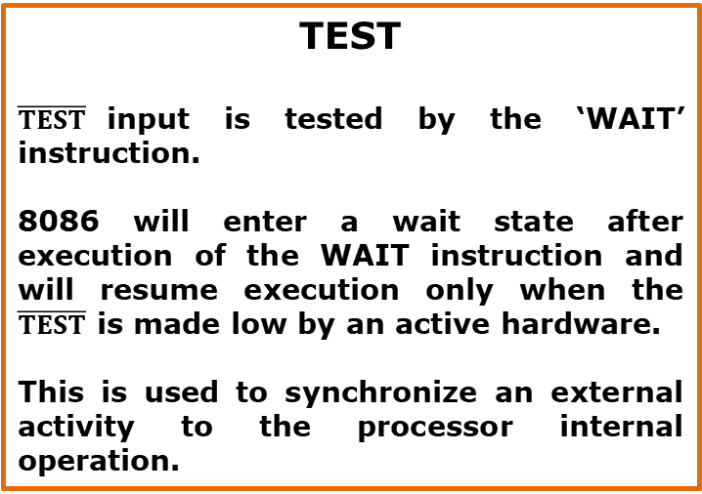
Pins and Signals
8086 Microprocessor
Common signals
TEST
$\overline{TEST}$input is tested by the ‘WAIT’ instruction.
8086 will enter a wait state after execution of the WAIT instruction and will resume execution only when the $\overline{TEST}$ is made low by an active hardware.
This is used to synchronize an external activity to the processor internal operation.
READY
This is the acknowledgement from the slow device or memory that they have completed the data transfer.
The signal made available by the devices is synchronized by the 8284A clock generator to provide ready input to the 8086.
The signal is active high.

Slide 10
Pins and Signals
8086 Microprocessor
Common signals
RESET (Input)
Causes the processor to immediately terminate its present activity.
The signal must be active HIGH for at least four clock cycles.
CLK
The clock input provides the basic timing for processor operation and bus control activity. Its an asymmetric square wave with 33% duty cycle.
INTR Interrupt Request
This is a triggered input. This is sampled during the last clock cycles of each instruction to determine the availability of the request. If any interrupt request is pending, the processor enters the interrupt acknowledge cycle.
This signal is active high and internally synchronized.

Slide 11
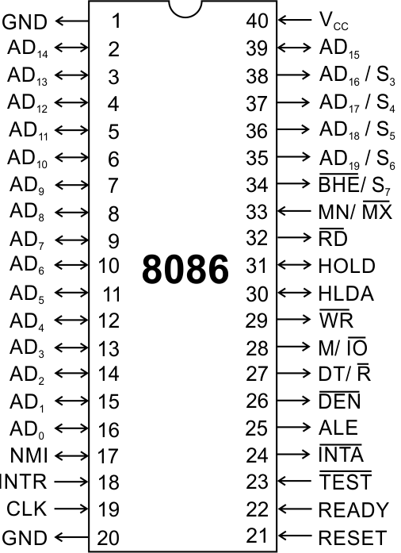
Pins and Signals
8086 Microprocessor
Min/ Max Pins
The 8086 microprocessor can work in two modes of operations : Minimum mode and Maximum mode.
In the minimum mode of operation the microprocessor do not associate with any co-processors and can not be used for multiprocessor systems.
In the maximum mode the 8086 can work in multi-processor or co-processor configuration.
Minimum or maximum mode operations are decided by the pin MN/ MX(Active low).
When this pin is high 8086 operates in minimum mode otherwise it operates in Maximum mode.

Slide 12


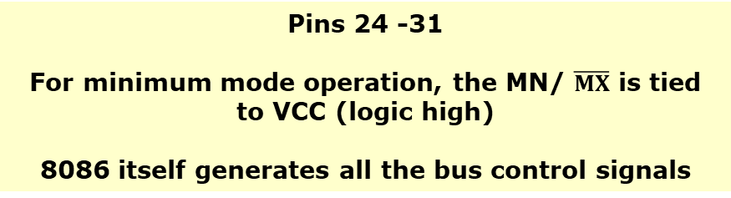

Pins and Signals
8086 Microprocessor
Minimum mode signals
Pins 24 -31
For minimum mode operation, the MN/ $\overline{MX}$ is tied to VCC (logic high)
8086 itself generates all the bus control signals
DT/$\overline{R}$ | (Data Transmit/ Receive) Output signal from the processor to control the direction of data flow through the data transceivers
$$\overline{DEN}$$ | (Data Enable) Output signal from the processor used as out put enable for the transceivers
ALE | (Address Latch Enable) Used to demultiplex the address and data lines using external latches
M/$\overline{IO}$ | Used to differentiate memory access and I/O access. For memory reference instructions, it is high. For IN and OUT instructions, it is low.
$$\overline{WR}$$ | Write control signal; asserted low Whenever processor writes data to memory or I/O port
$$\overline{INTA}$$ | (Interrupt Acknowledge) When the interrupt request is accepted by the processor, the output is low on this line.

Slide 13
Pins and Signals
8086 Microprocessor
Minimum mode signals
Pins 24 -31
For minimum mode operation, the MN/ $\overline{MX}$ is tied to VCC (logic high)
8086 itself generates all the bus control signals
HOLD | Input signal to the processor form the bus masters as a request to grant the control of the bus. Usually used by the DMA controller to get the control of the bus.
HLDA | (Hold Acknowledge) Acknowledge signal by the processor to the bus master requesting the control of the bus through HOLD. The acknowledge is asserted high, when the processor accepts HOLD.

Slide 14
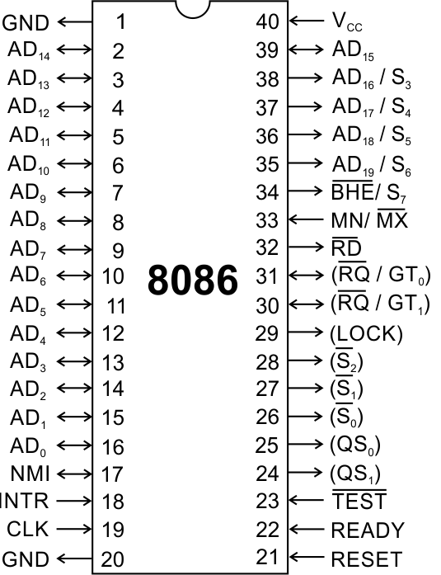
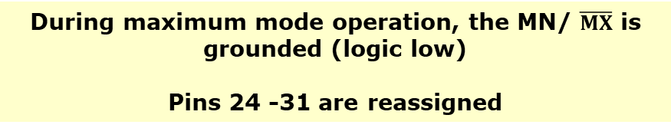
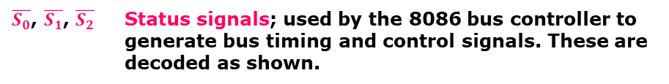
Pins and Signals
8086 Microprocessor
Maximum mode signals
During maximum mode operation, the MN/ $\overline{MX}$ is grounded (logic low)
Pins 24 -31 are reassigned
$\overline{S_{0}}$, $\overline{S_{1}}$, $\overline{S_{2}}$ | Status signals; used by the 8086 bus controller to generate bus timing and control signals. These are decoded as shown.

Slide 15
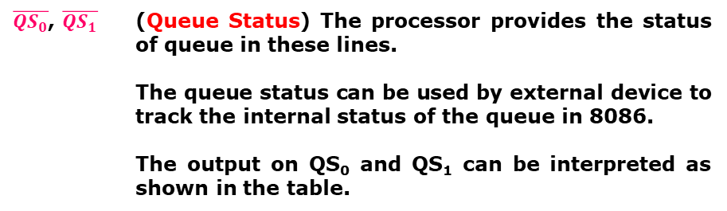
Pins and Signals
8086 Microprocessor
Maximum mode signals
During maximum mode operation, the MN/ $\overline{MX}$ is grounded (logic low)
Pins 24 -31 are reassigned
$\overline{{QS}_{0}}$, $\overline{QS_{1}}$ | (Queue Status) The processor provides the status of queue in these lines. The queue status can be used by external device to track the internal status of the queue in 8086. The output on QS₀ and QS₁ can be interpreted as shown in the table.

Slide 16
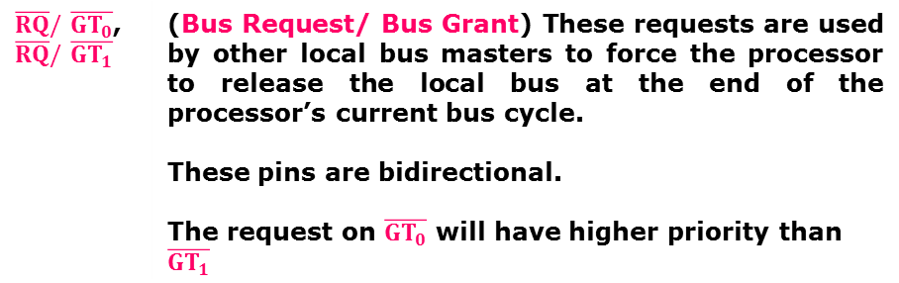
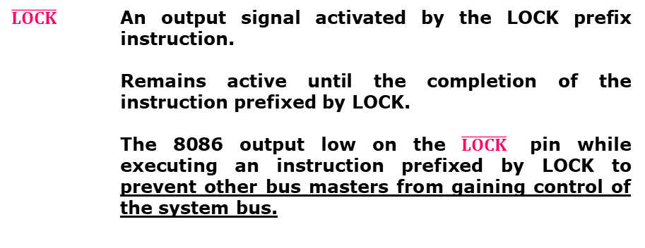
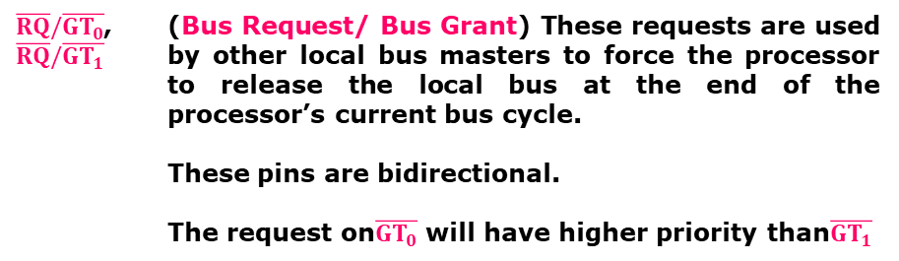
Pins and Signals
8086 Microprocessor
Maximum mode signals
During maximum mode operation, the MN/ $\overline{MX}$ is grounded (logic low)
Pins 24 -31 are reassigned
$\overline{RQ}/\overline{GT_{0}}$, $\overline{RQ}/\overline{GT_{1}}$ | (Bus Request/ Bus Grant) These requests are used by other local bus masters to force the processor to release the local bus at the end of the processor’s current bus cycle. These pins are bidirectional. The request on$\overline{GT_{0}}$ will have higher priority than$\overline{GT_{1}}$
$$\overline{LOCK}$$ | An output signal activated by the LOCK prefix instruction. Remains active until the completion of the instruction prefixed by LOCK. The 8086 output low on the $\overline{LOCK}$ pin while executing an instruction prefixed by LOCK to prevent other bus masters from gaining control of the system bus.

Slide 17
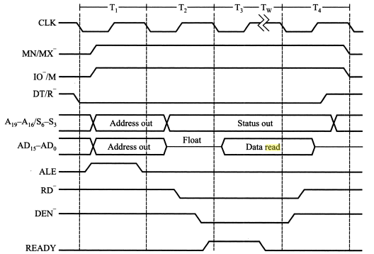
Timing Diagram

Slide 18
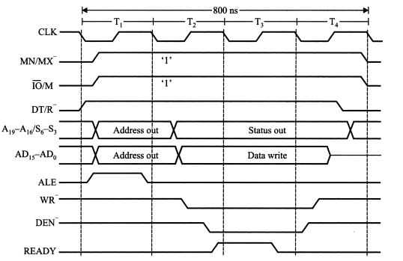

Slide 19
Architecture

Slide 20
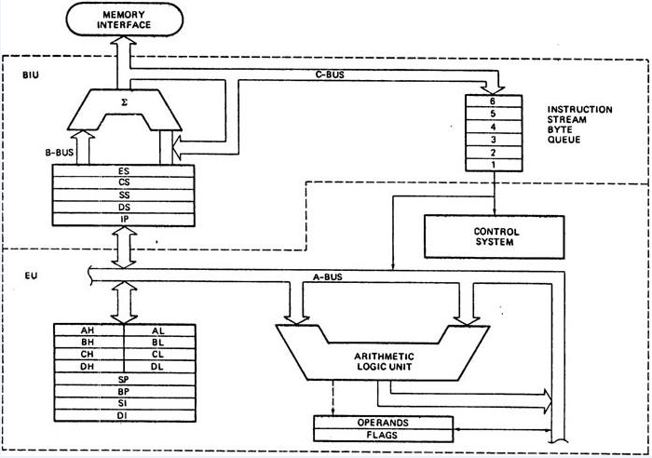
8086 ARCHITECTURE

Slide 21
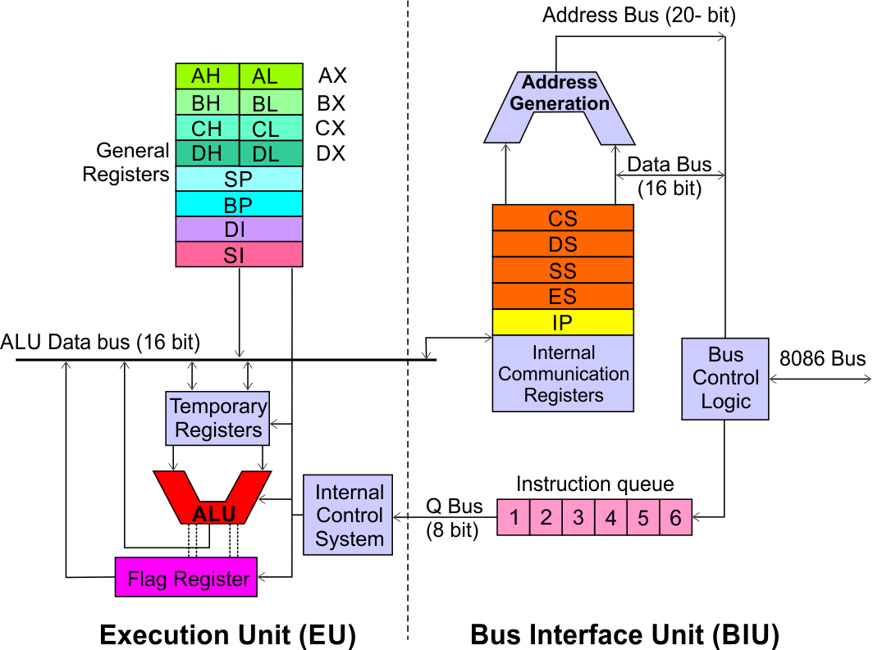
Architecture
8086 Microprocessor
Execution Unit (EU)
EU executes instructions that have already been fetched by the BIU.
BIU and EU functions separately.
Bus Interface Unit (BIU)
BIU fetches instructions, reads data from memory and I/O ports, writes data to memory and I/ O ports.

Slide 22
Architecture
8086 Microprocessor
Bus Interface Unit (BIU)
Dedicated Adder to generate 20 bit address
Four 16-bit segment registers
Code Segment (CS)
Data Segment (DS)
Stack Segment (SS)
Extra Segment (ES)
Segment Registers >>

Slide 23
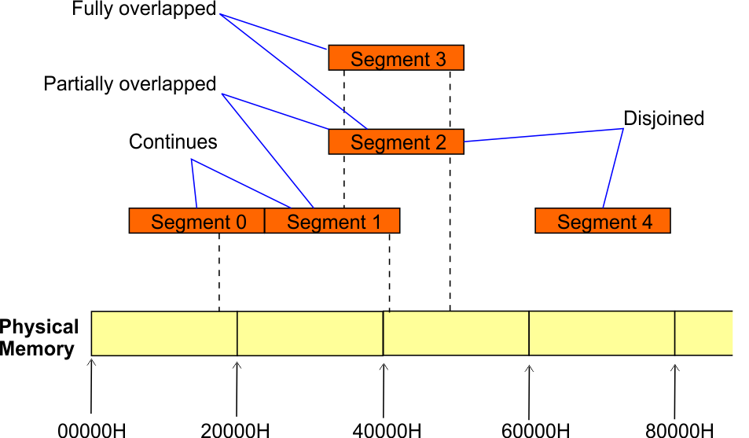
Architecture
8086 Microprocessor
Bus Interface Unit (BIU)
Segment
Registers
8086’s 1-megabyte memory is divided into segments of up to 64K bytes each.
The 8086 can directly address four segments (256 K bytes within the 1 M byte of memory) at a particular time.
Programs obtain access to code and data in the segments by changing the segment register content to point to the desired segments.

Slide 24
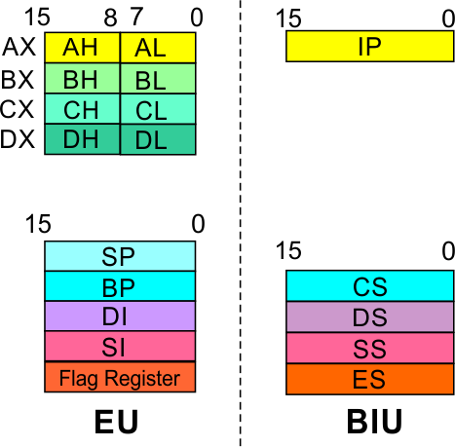
Architecture
8086 Microprocessor
Bus Interface Unit (BIU)
Segment
Registers
Code Segment Register
16-bit
CS contains the base or start of the current code segment; IP contains the distance or offset from this address to the next instruction byte to be fetched.
BIU computes the 20-bit physical address by logically shifting the contents of CS 4-bits to the left and then adding the 16-bit contents of IP.
That is, all instructions of a program are relative to the contents of the CS register multiplied by 16 and then offset is added provided by the IP.

Slide 25
Architecture
8086 Microprocessor
Bus Interface Unit (BIU)
Segment
Registers
Data Segment Register
16-bit
Points to the current data segment; operands for most instructions are fetched from this segment.
The 16-bit contents of the Source Index (SI) or Destination Index (DI) or a 16-bit displacement are used as offset for computing the 20-bit physical address.

Slide 26
Architecture
8086 Microprocessor
Bus Interface Unit (BIU)
Segment
Registers
Stack Segment Register
16-bit
Points to the current stack.
The 20-bit physical stack address is calculated from the Stack Segment (SS) and the Stack Pointer (SP) for stack instructions such as PUSH and POP.
In based addressing mode, the 20-bit physical stack address is calculated from the Stack segment (SS) and the Base Pointer (BP).

Slide 27
Architecture
8086 Microprocessor
Bus Interface Unit (BIU)
Segment
Registers
Extra Segment Register
16-bit
Points to the extra segment in which data (in excess of 64K pointed to by the DS) is stored.
String instructions use the ES and DI to determine the 20-bit physical address for the destination.

Slide 28
Architecture
8086 Microprocessor
Bus Interface Unit (BIU)
Segment
Registers
Instruction Pointer
16-bit
Always points to the next instruction to be executed within the currently executing code segment.
So, this register contains the 16-bit offset address pointing to the next instruction code within the 64Kb of the code segment area.
Its content is automatically incremented as the execution of the next instruction takes place.

Slide 29
Architecture
8086 Microprocessor
Bus Interface Unit (BIU)
Instruction queue
A group of First-In-First-Out (FIFO) in which up to 6 bytes of instruction code are pre fetched from the memory ahead of time.
This is done in order to speed up the execution by overlapping instruction fetch with execution.
This mechanism is known as pipelining.

Slide 30
Architecture
8086 Microprocessor
Execution Unit (EU)
EU decodes and executes instructions.
A decoder in the EU control system translates instructions.
16-bit ALU for performing arithmetic and logic operation
Four general purpose registers(AX, BX, CX, DX);
Pointer registers (Stack Pointer, Base Pointer);
and
Index registers (Source Index, Destination Index) each of 16-bits
Some of the 16 bit registers can be used as two 8 bit registers as :
AX can be used as AH and AL
BX can be used as BH and BL
CX can be used as CH and CL
DX can be used as DH and DL

Slide 31
Architecture
8086 Microprocessor
Execution Unit (EU)
EU
Registers
Accumulator Register (AX)
Consists of two 8-bit registers AL and AH, which can be combined together and used as a 16-bit register AX.
AL in this case contains the low order byte of the word, and AH contains the high-order byte.
The I/O instructions use the AX or AL for inputting / outputting 16 or 8 bit data to or from an I/O port.
Multiplication and Division instructions also use the AX or AL.

Slide 32
Architecture
8086 Microprocessor
Execution Unit (EU)
EU
Registers
Base Register (BX)
Consists of two 8-bit registers BL and BH, which can be combined together and used as a 16-bit register BX.
BL in this case contains the low-order byte of the word, and BH contains the high-order byte.
This is the only general purpose register whose contents can be used for addressing the 8086 memory.
All memory references utilizing this register content for addressing use DS as the default segment register.

Slide 33
Architecture
8086 Microprocessor
Execution Unit (EU)
EU
Registers
Counter Register (CX)
Consists of two 8-bit registers CL and CH, which can be combined together and used as a 16-bit register CX.
When combined, CL register contains the low order byte of the word, and CH contains the high-order byte.
Instructions such as SHIFT, ROTATE and LOOP use the contents of CX as a counter.
Example:
The instruction LOOP START automatically decrements CX by 1 without affecting flags and will check if [CX] = 0.
If it is zero, 8086 executes the next instruction; otherwise the 8086 branches to the label START.

Slide 34
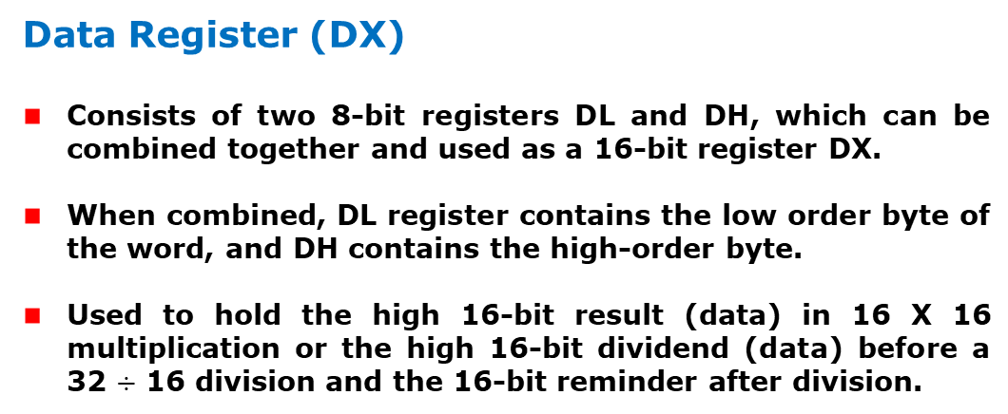
Architecture
8086 Microprocessor
Execution Unit (EU)
EU
Registers
Data Register (DX)
Consists of two 8-bit registers DL and DH, which can be combined together and used as a 16-bit register DX.
When combined, DL register contains the low order byte of the word, and DH contains the high-order byte.
Used to hold the high 16-bit result (data) in 16 X 16 multiplication or the high 16-bit dividend (data) before a 32 $÷$ 16 division and the 16-bit reminder after division.

Slide 35
Architecture
8086 Microprocessor
Execution Unit (EU)
EU
Registers
Stack Pointer (SP) and Base Pointer (BP)
SP and BP are used to access data in the stack segment.
SP is used as an offset from the current SS during execution of instructions that involve the stack segment in the external memory.
SP contents are automatically updated (incremented/ decremented) due to execution of a POP or PUSH instruction.
BP contains an offset address in the current SS, which is used by instructions utilizing the based addressing mode.

Slide 36
Architecture
8086 Microprocessor
Execution Unit (EU)
EU
Registers
Source Index (SI) and Destination Index (DI)
Used in indexed addressing.
Instructions that process data strings use the SI and DI registers together with DS and ES respectively in order to distinguish between the source and destination addresses.

Slide 37
Architecture
8086 Microprocessor
Execution Unit (EU)
EU
Registers
Source Index (SI) and Destination Index (DI)
Used in indexed addressing.
Instructions that process data strings use the SI and DI registers together with DS and ES respectively in order to distinguish between the source and destination addresses.

Slide 38
Practice Problems
Calculate the physical address for the following
Segment address-1005H,Offset address-5555H
Segment address-1234H,Offset address-5678H
What is the status of flag register after the execution of the following
ADD 5CH,45H
ADD BBH,5CH

Slide 39
Architecture
8086 Microprocessor
Execution Unit (EU)
Auxiliary Carry Flag
This is set, if there is a carry from the lowest nibble, i.e, bit three during addition, or borrow for the lowest nibble, i.e, bit three, during subtraction.
Carry Flag
This flag is set, when there is a carry out of MSB in case of addition or a borrow in case of subtraction.
Flag Register
Sign Flag
This flag is set, when the result of any computation is negative
Zero Flag
This flag is set, if the result of the computation or comparison performed by an instruction is zero
Parity Flag
This flag is set to 1, if the lower byte of the result contains even number of 1’s ; for odd number of 1’s set to zero.
15 | 14 | 13 | 12 | 11 | 10 | 9 | 8 | 7 | 6 | 5 | 4 | 3 | 2 | 1 | 0
 |  |  |  | OF | DF | IF | TF | SF | ZF |  | AF |  | PF |  | CF
Over flow Flag
This flag is set, if an overflow occurs, i.e, if the result of a signed operation is large enough to accommodate in a destination register. The result is of more than 7-bits in size in case of 8-bit signed operation and more than 15-bits in size in case of 16-bit sign operations, then the overflow will be set.
Trap Flag
If this flag is set, the processor enters the single step execution mode by generating internal interrupts after the execution of each instruction
Direction Flag
This is used by string manipulation instructions. If this flag bit is ‘0’, the string is processed beginning from the lowest address to the highest address, i.e., auto incrementing mode. Otherwise, the string is processed from the highest address towards the lowest address, i.e., auto incrementing mode.
Interrupt Flag
Causes the 8086 to recognize external mask interrupts; clearing IF disables these interrupts.

Slide 40
Practice Problems
Describe what happens to the status flags as the sequence of instructions that follows is executed in 8086 microprocessor architecture.
Assume that flags ZF, SF, CF, AF, OF and PF are initially reset.
MOV AX, 1234H
MOV BX, 0ABCDH
CMP AX, BX

Slide 41
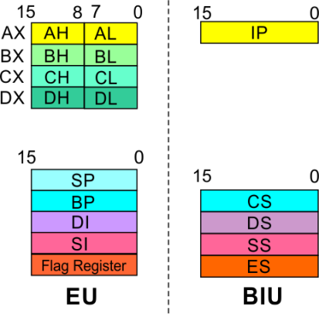
8086 Microprocessor
Architecture
8086 registers categorized into 4 groups
15 | 14 | 13 | 12 | 11 | 10 | 9 | 8 | 7 | 6 | 5 | 4 | 3 | 2 | 1 | 0
 |  |  |  | OF | DF | IF | TF | SF | ZF |  | AF |  | PF |  | CF
Sl.No. | Type | Register width | Name of register
1 | General purpose register | 16 bit | AX, BX, CX, DX
 |  | 8 bit | AL, AH, BL, BH, CL, CH, DL, DH
2 | Pointer register | 16 bit | SP, BP
3 | Index register | 16 bit | SI, DI
4 | Instruction Pointer | 16 bit | IP
5 | Segment register | 16 bit | CS, DS, SS, ES
6 | Flag (PSW) | 16 bit | Flag register

Slide 42
8086 Microprocessor
Architecture
Registers and Special Functions
Register | Name of the Register | Special Function
AX | 16-bit Accumulator | Stores the 16-bit results of arithmetic and logic operations
AL | 8-bit Accumulator | Stores the 8-bit results of arithmetic and logic operations
BX | Base register | Used to hold base value in base addressing mode to access memory data
CX | Count Register | Used to hold the count value in SHIFT, ROTATE and LOOP instructions
DX | Data Register | Used to hold data for multiplication and division operations
SP | Stack Pointer | Used to hold the offset address of top stack memory
BP | Base Pointer | Used to hold the base value in base addressing using SS register to access data from stack memory
SI | Source Index | Used to hold index value of source operand (data) for string instructions
DI | Data Index | Used to hold the index value of destination operand (data) for string operations

Slide 43
Default Segment & Offset Registers
Default Segment | Offset | Memory operation
CS | IP | Instruction fetch
SS | SP,BP or effective address Using BP as one of the register | Stack operation
DS | BX/SI/DI or effective address using above registers | General data access
DS | SI | Source string data access
ES | DI | Destination string data access

Slide 44
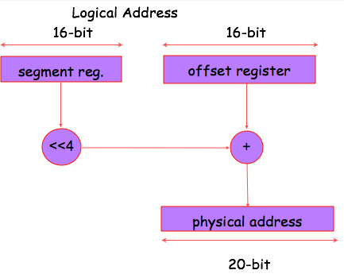
Generating 20-bit Physical address

Slide 45
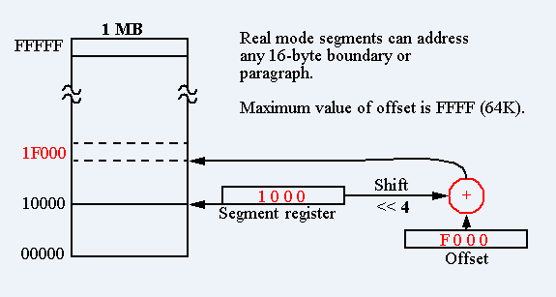

Slide 46
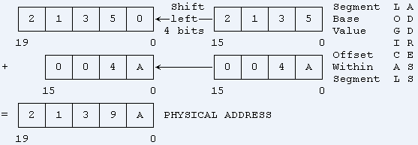
Advantages of Memory Segmentation
It allows the memory capacity to be 1MB even though the actual addresses to be handled by instructions are 16-bits
It allows use of separate memory areas for program, data & stack, thus the protection of these is possible.
For large programs , it can use multiple segments for program code, Data & Stack.
Program relocation can be very easily done.

Slide 47
Physical Memory organization
FFFFFH FFFFEH
FFFFDH FFFFCH
512KB 512KB
00003H 00002H
[
00001H 00000H
Higher bank( Odd Bank) Lower bank( Even Bank)
BHE | A0 | Type of data transfer and bank selection
0 | 0 | 16-bit data transfer, both banks selected
0 | 1 | 8-bit data transfer, odd bank selected
1 | 0 | 8-bit data transfer , even bank selected
1 | 1 | No data transfer , both banks disabled

Slide 48
Introduction
8086 Microprocessor
Program
A set of instructions written to solve a problem.
Instruction
Directions which a microprocessor follows to execute a task or part of a task.
Computer language
High Level
Low Level
Machine Language
Assembly Language
 Binary bits
English Alphabets
‘Mnemonics’
Assembler Mnemonics → Machine Language

Slide 49
ADDRESSING MODES

Slide 50
Addressing Modes
8086 Microprocessor
Every instruction of a program has to operate on a data.
The different ways in which a source operand is denoted in an instruction are known as addressing modes.
Register Addressing
Immediate Addressing
Direct Addressing
Register Indirect Addressing
Based Addressing
Indexed Addressing
Based Index Addressing
String Addressing
Direct I/O port Addressing
10. Indirect I/O port Addressing
11. Relative Addressing
12. Implied Addressing
Group I : Addressing modes for register and immediate data
Group II : Addressing modes for memory data
Group III : Addressing modes for I/O ports
Group IV : Relative Addressing mode
Group V : Implied Addressing mode

Slide 51
Addressing Modes
8086 Microprocessor
Group I : Addressing modes for register and immediate data
Register Addressing
Immediate Addressing
Direct Addressing
Register Indirect Addressing
Based Addressing
Indexed Addressing
Based Index Addressing
String Addressing
Direct I/O port Addressing
10. Indirect I/O port Addressing
11. Relative Addressing
12. Implied Addressing
The instruction will specify the name of the register which holds the data to be operated by the instruction.
Example:
MOV CL, DH
The content of 8-bit register DH is moved to another 8-bit register CL
(CL) ← (DH)

Slide 52

Addressing Modes
8086 Microprocessor
Group I : Addressing modes for register and immediate data
Register Addressing
Immediate Addressing
Direct Addressing
Register Indirect Addressing
Based Addressing
Indexed Addressing
Based Index Addressing
String Addressing
Direct I/O port Addressing
10. Indirect I/O port Addressing
11. Relative Addressing
12. Implied Addressing
In immediate addressing mode, an 8-bit or 16-bit data is specified as part of the instruction
Example:
MOV DL, 08H
The 8-bit data (08_{H}) given in the instruction is moved to DL
(DL) ← 08_{H}
MOV AX, 0A9FH
The 16-bit data (0A9F_{H}) given in the instruction is moved to AX register
(AX) ← 0A9F_{H}

Slide 53
Addressing Modes : Memory Access
8086 Microprocessor
Offset Value (16 bits)
Segment Register (16 bits)
0 0 0 0
Adder
Physical Address (20 Bits)

Slide 54
Addressing Modes : Memory Access
8086 Microprocessor
20 Address lines ⇒ 8086 can address up to 2²⁰ = 1M bytes of memory
However, the largest register is only 16 bits
Physical Address will have to be calculated Physical Address : Actual address of a byte in memory. i.e. the value which goes out onto the address bus.
Memory Address represented in the form – Seg : Offset (Eg - 89AB:F012)
Each time the processor wants to access memory, it takes the contents of a segment register, shifts it one hexadecimal place to the left (same as multiplying by 16₁₀), then add the required offset to form the 20- bit address
16 bytes of contiguous memory
89AB : F012 → 89AB → 89AB0 (Paragraph to byte → 89AB x 10 = 89AB0)
F012 → 0F012 (Offset is already in byte unit)
+ -------
98AC2 (The absolute address)

Slide 55
Addressing Modes : Memory Access
8086 Microprocessor
To access memory we use these four registers: BX, SI, DI, BP
Combining these registers inside [ ] symbols, we can get different memory locations (Effective Address, EA)
Supported combinations:
[BX + SI] [BX + DI] [BP + SI] [BP + DI] | [SI] [DI] d16 (variable offset only) [BX] | [BX + SI + d8] [BX + DI + d8] [BP + SI + d8] [BP + DI + d8]
[SI + d8] [DI + d8] [BP + d8] [BX + d8] | [BX + SI + d16] [BX + DI + d16] [BP + SI + d16] [BP + DI + d16] | [SI + d16] [DI + d16] [BP + d16] [BX + d16]
BX BP | SI DI | + disp

Slide 56
Addressing Modes
8086 Microprocessor
Group II : Addressing modes for memory data
Register Addressing
Immediate Addressing
Direct Addressing
Register Indirect Addressing
Based Addressing
Indexed Addressing
Based Index Addressing
String Addressing
Direct I/O port Addressing
10. Indirect I/O port Addressing
11. Relative Addressing
12. Implied Addressing
Here, the effective address of the memory location at which the data operand is stored is given in the instruction.
The effective address is just a 16-bit number written directly in the instruction.
Example:
MOV BX, [1354H]
MOV BL, [0400H]
The square brackets around the 1354_{H} denotes the contents of the memory location. When executed, this instruction will copy the contents of the memory location into BX register.
This addressing mode is called direct because the displacement of the operand from the segment base is specified directly in the instruction.

Slide 57
Addressing Modes
8086 Microprocessor
Group II : Addressing modes for memory data
Register Addressing
Immediate Addressing
Direct Addressing
Register Indirect Addressing
Based Addressing
Indexed Addressing
Based Index Addressing
String Addressing
Direct I/O port Addressing
10. Indirect I/O port Addressing
11. Relative Addressing
12. Implied Addressing
In Register indirect addressing, name of the register which holds the effective address (EA) will be specified in the instruction.
Registers used to hold EA are any of the following registers:
BX, BP, DI and SI.
Content of the DS register is used for base address calculation.
Example:
MOV CX, [BX]
Operations:
    EA = (BX)
    BA = (DS) x 16₁₀
    MA = BA + EA
    (CX) ← (MA) or,
    (CL) ← (MA)
    (CH) ← (MA +1)
Note : Register/ memory enclosed in brackets refer to content of register/ memory

Slide 58
Addressing Modes
8086 Microprocessor
Group II : Addressing modes for memory data
Register Addressing
Immediate Addressing
Direct Addressing
Register Indirect Addressing
Based Addressing
Indexed Addressing
Based Index Addressing
String Addressing
Direct I/O port Addressing
10. Indirect I/O port Addressing
11. Relative Addressing
12. Implied Addressing
In Based Addressing, BX or BP is used to hold the base value for effective address and a signed 8-bit or unsigned 16-bit displacement will be specified in the instruction.
In case of 8-bit displacement, it is sign extended to 16-bit before adding to the base value.
When BX holds the base value of EA, 20-bit physical address is calculated from BX and DS.
When BP holds the base value of EA, BP and SS is used.
Example:
MOV AX, [BX + 08H]
Operations:
    0008_{H} ← 08_{H} (Sign extended)
    EA = (BX) + 0008_{H}
    BA = (DS) x 16₁₀
    MA = BA + EA
    (AX) ← (MA) or,
    (AL) ← (MA)
    (AH) ← (MA + 1)

Slide 59
Addressing Modes
8086 Microprocessor
Group II : Addressing modes for memory data
Register Addressing
Immediate Addressing
Direct Addressing
Register Indirect Addressing
Based Addressing
Indexed Addressing
Based Index Addressing
String Addressing
Direct I/O port Addressing
10. Indirect I/O port Addressing
11. Relative Addressing
12. Implied Addressing
SI or DI register is used to hold an index value for memory data and a signed 8-bit or unsigned 16-bit displacement will be specified in the instruction.
Displacement is added to the index value in SI or DI register to obtain the EA.
In case of 8-bit displacement, it is sign extended to 16-bit before adding to the base value.
Example:
MOV CX, [SI + 0A2H]
    Operations:
      FFA2_{H} ← A2_{H} (Sign extended)
      EA = (SI) + FFA2_{H}
      BA = (DS) x 16₁₀
      MA = BA + EA
      (CX) ← (MA) or,
      (CL) ← (MA)
      (CH) ← (MA + 1)

Slide 60
Addressing Modes
8086 Microprocessor
Group II : Addressing modes for memory data
Register Addressing
Immediate Addressing
Direct Addressing
Register Indirect Addressing
Based Addressing
Indexed Addressing
Based Index Addressing
String Addressing
Direct I/O port Addressing
10. Indirect I/O port Addressing
11. Relative Addressing
12. Implied Addressing
In Based Index Addressing, the effective address is computed from the sum of a base register (BX or BP), an index register (SI or DI) and a displacement.
Example:
MOV DX, [BX + SI + 0AH]
    Operations:
      000A_{H} ← 0A_{H} (Sign extended)
      EA = (BX) + (SI) + 000A_{H}
      BA = (DS) x 16₁₀
      MA = BA + EA
      (DX) ← (MA) or,
      (DL) ← (MA)
      (DH) ← (MA + 1)

Slide 61
Addressing Modes
8086 Microprocessor
Group II : Addressing modes for memory data
Register Addressing
Immediate Addressing
Direct Addressing
Register Indirect Addressing
Based Addressing
Indexed Addressing
Based Index Addressing
String Addressing
Direct I/O port Addressing
10. Indirect I/O port Addressing
11. Relative Addressing
12. Implied Addressing
Employed in string operations to operate on string data.
The effective address (EA) of source data is stored in SI register and the EA of destination is stored in DI register.
Segment register for calculating base address of
source data is DS and that of the destination data is ES
    Example: MOVS BYTE
Operations:
Calculation of source memory location:
EA = (SI) BA = (DS) x 16₁₀ MA = BA + EA
Calculation of destination memory location:
EA_{E} = (DI) BA_{E} = (ES) x 16₁₀ MA_{E} = BA_{E} + EA_{E}
(MAE) ← (MA)
If DF = 1, then (SI) ← (SI) – 1 and (DI) = (DI) - 1
If DF = 0, then (SI) ← (SI) +1 and (DI) = (DI) + 1
Note : Effective address of the Extra segment register

Slide 62
Addressing Modes
8086 Microprocessor
Group III : Addressing modes for I/O ports
Register Addressing
Immediate Addressing
Direct Addressing
Register Indirect Addressing
Based Addressing
Indexed Addressing
Based Index Addressing
String Addressing
Direct I/O port Addressing
10. Indirect I/O port Addressing
11. Relative Addressing
12. Implied Addressing
These addressing modes are used to access data from standard I/O mapped devices or ports.
In direct port addressing mode, an 8-bit port address is directly specified in the instruction.
    Example: IN AL, [09H]
Operations: PORT_{addr} = 09_{H}
(AL) ← (PORT)
Content of port with address 09_{H} is moved to AL register
In indirect port addressing mode, the instruction will specify the name of the register which holds the port address. In 8086, the 16-bit port address is stored in the DX register.
    Example: OUT [DX], AX
Operations: PORT_{addr} = (DX)
(PORT) ← (AX)
Content of AX is moved to port whose address is specified by DX register.

Slide 63
Addressing Modes
8086 Microprocessor
Group IV : Relative Addressing mode
Register Addressing
Immediate Addressing
Direct Addressing
Register Indirect Addressing
Based Addressing
Indexed Addressing
Based Index Addressing
String Addressing
Direct I/O port Addressing
10. Indirect I/O port Addressing
11. Relative Addressing
12. Implied Addressing
In this addressing mode, the effective address of a program instruction is specified relative to Instruction Pointer (IP) by an 8-bit signed displacement.
Example: JZ 0AH
Operations:
  000A_{H} ← 0A_{H} (sign extend)
  If ZF = 1, then
  EA = (IP) + 000A_{H}
  BA = (CS) x 16₁₀
  MA = BA + EA
  If ZF = 1, then the program control jumps to new address calculated above.
  If ZF = 0, then next instruction of the program is executed.

Slide 64
Addressing Modes
8086 Microprocessor
Group IV : Implied Addressing mode
Register Addressing
Immediate Addressing
Direct Addressing
Register Indirect Addressing
Based Addressing
Indexed Addressing
Based Index Addressing
String Addressing
Direct I/O port Addressing
10. Indirect I/O port Addressing
11. Relative Addressing
12. Implied Addressing
Instructions using this mode have no operands. The instruction itself will specify the data to be operated by the instruction.
Example: CLC
This clears the carry flag to zero.

